Slide 1
Data Profession Career shift
Agenda
Global Perspective
Top 10 Job tiles
Top Regions with highest density
Europe Perspective

Slide 2
Global Perspective
Dataset contains 73.412 entries

Slide 3
Columns Overview:
work_year: The year of the data entry (e.g., 2024, 2025).
experience_level: The level of experience (e.g., SE for Senior, MI for Mid-level).
employment_type: The type of employment (e.g., FT for Full-Time).
job_title: The title of the job (e.g., Data Scientist, Machine Learning Engineer).
salary: The salary in the original currency.
salary_currency: The currency of the salary (e.g., USD, EUR).
salary_in_usd: Salary converted to USD.
employee_residence: Country of residence of the employee.
remote_ratio: Percentage of remote work (e.g., 0 for on-site, 100 for fully remote).
company_location: The location of the company.
company_size: Size of the company (e.g., S for Small, M for Medium, L for Large).

Slide 4
Key Observations:
Experience Levels: 4 categories, most frequent is "SE" (Senior Experience).
Employment Type: Majority are "FT" (Full-Time).
Job Titles: 289 unique titles, most common is "Data Scientist."
Currency: 25 unique currencies; USD is the most frequent.
Remote Work: Most entries indicate no remote work (remote_ratio = 0).
Company Size: Predominantly medium-sized companies ("M").

Slide 5
Numerical Data Insights:
Salary (USD):
Mean: 157,970 USD
Median: 147,500 USD
Min: 15,000 USD
Max: 800,000 USD
Remote Ratio:
Mean: 21.55%
Median: 0% (most jobs are on-site)
Range: 0% to 100%

Slide 6
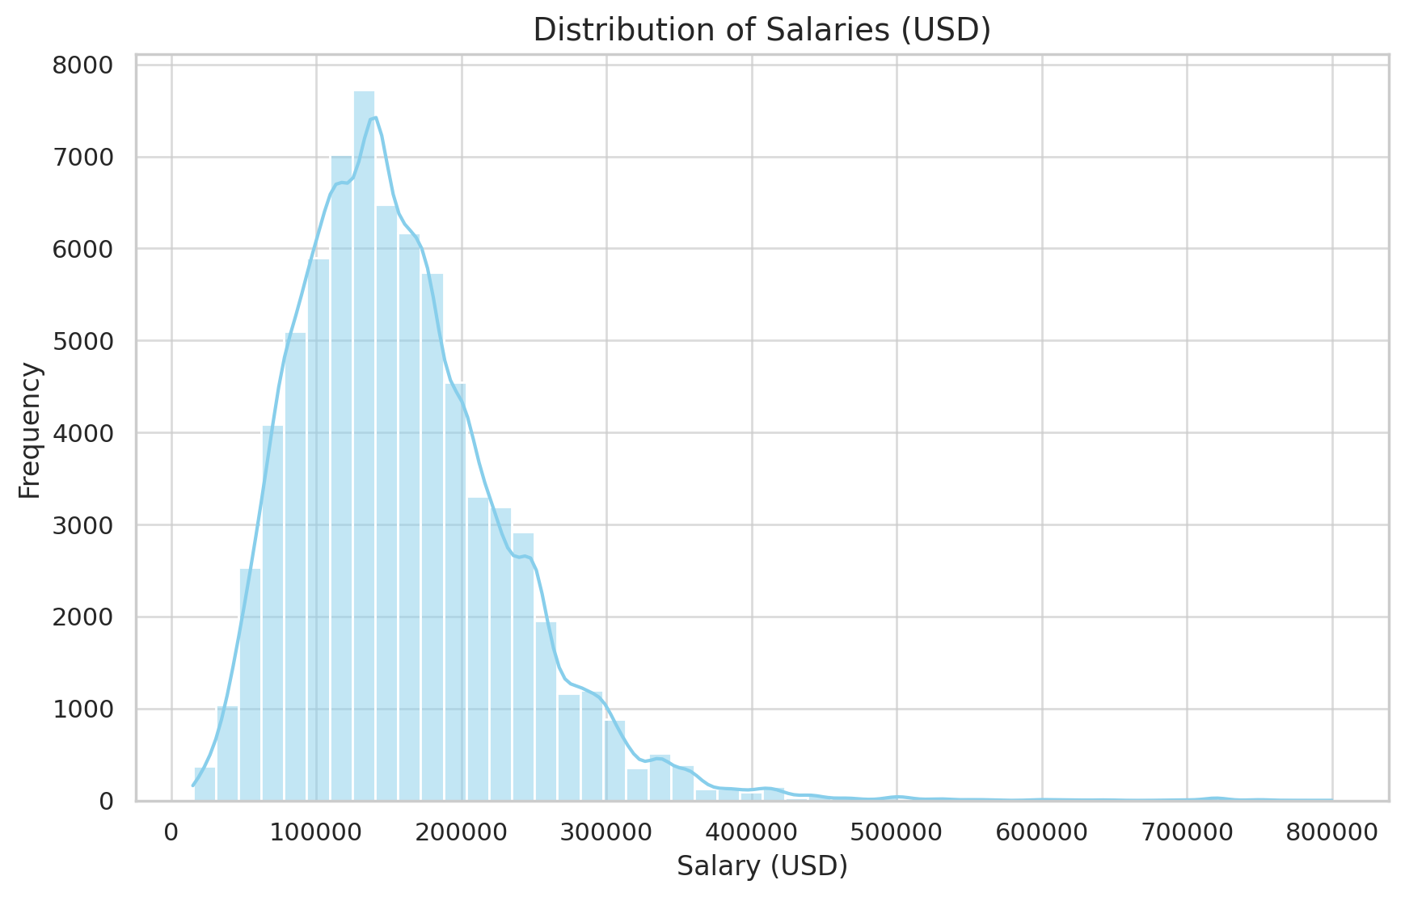
Salary Distribution:
Most salaries are concentrated between $100,000 and $200,000, with a few outliers reaching up to $800,000.

Slide 7
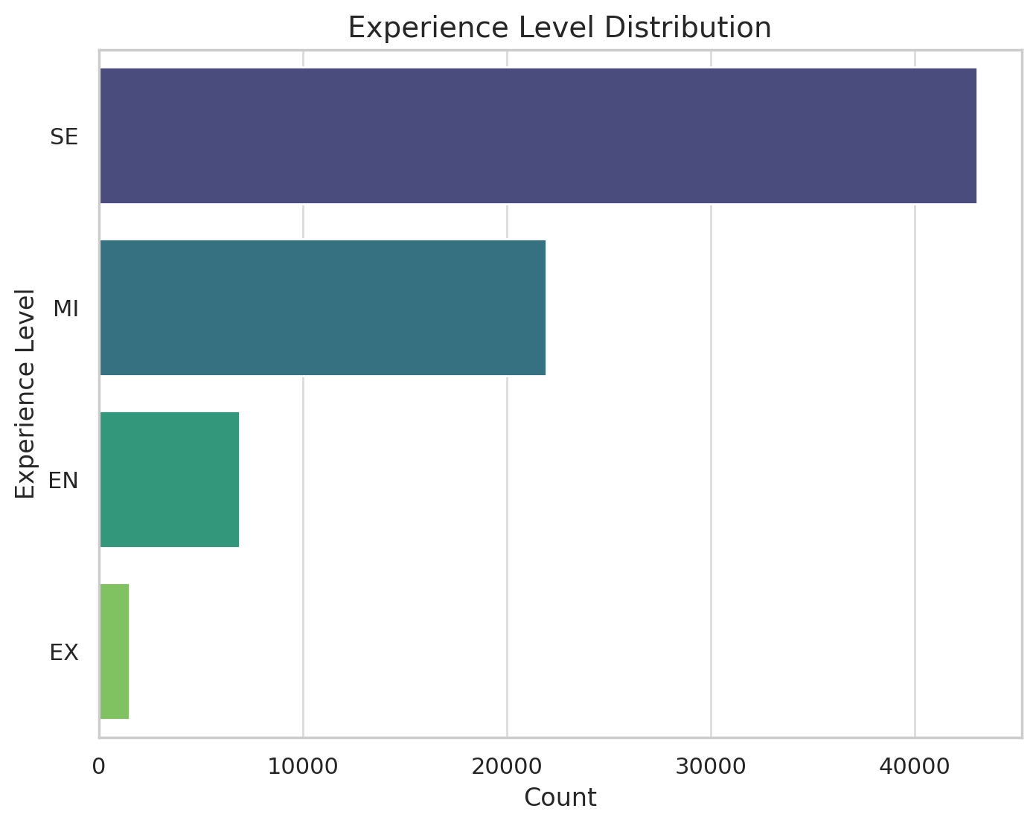
Experience Levels:
Senior Experience ("SE") dominates the dataset, followed by Mid-level ("MI").

Slide 8
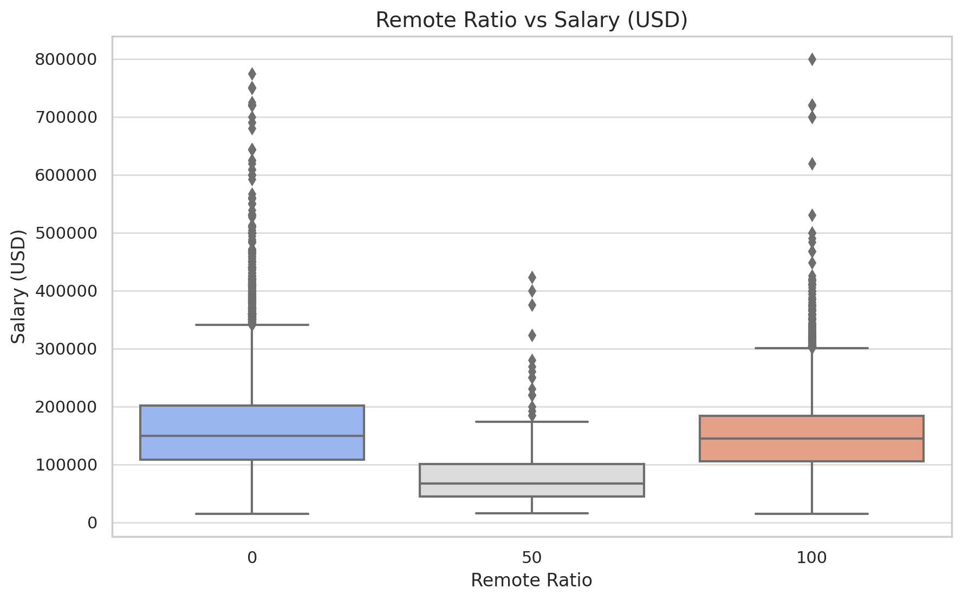
Remote Ratio vs Salary:
Fully remote roles (100% remote ratio) tend to have higher salary variability.
On-site roles (0% remote) also show a broad salary range, but slightly lower median values compared to remote roles.

Slide 9
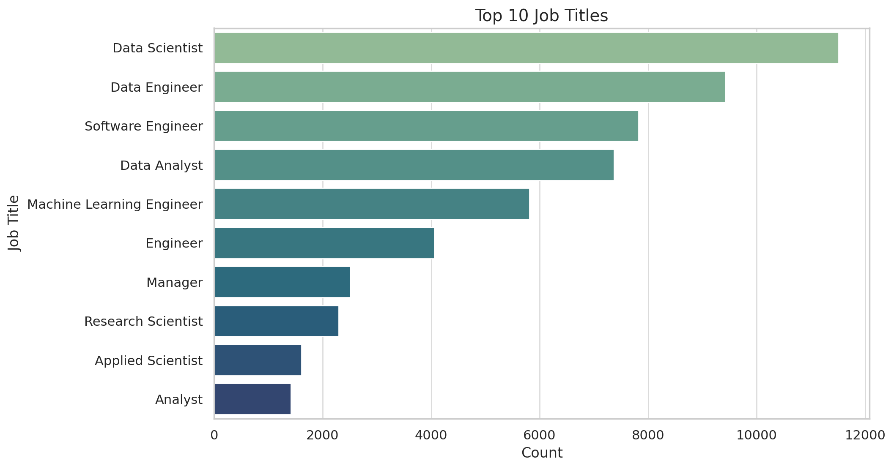
Top 10 Job Titles:
"Data Scientist" is the most frequent job, followed by roles like "Data Engineer" and "Machine Learning Engineer."

Slide 10
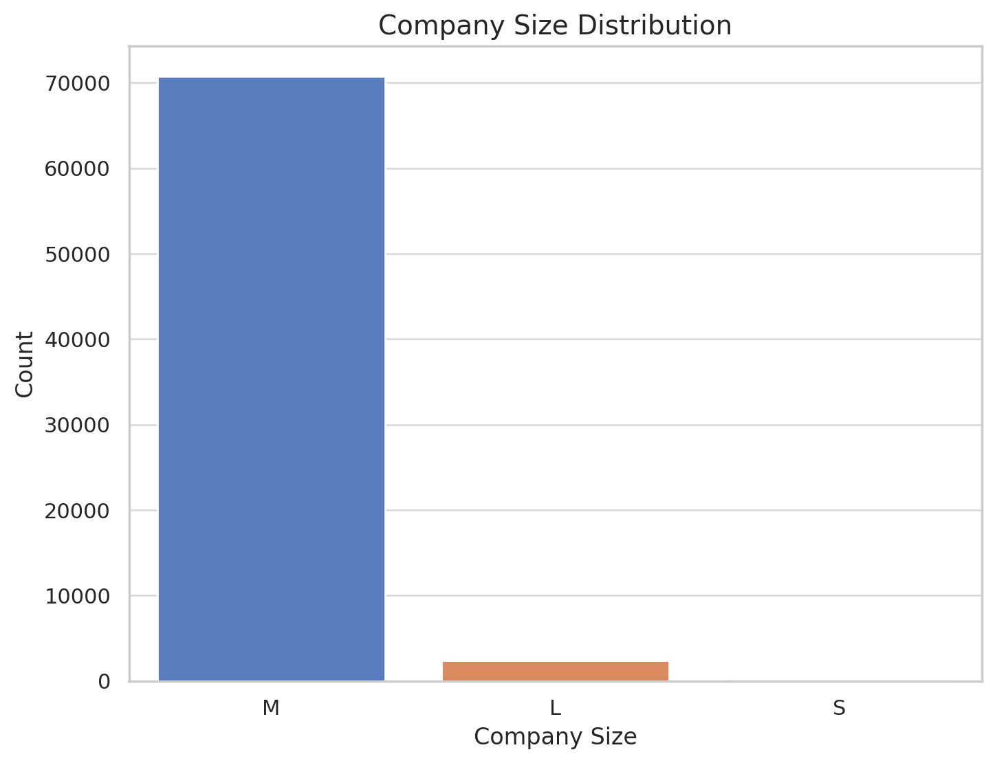
Company Size Distribution:
Medium-sized companies ("M") are the most common, significantly outnumbering small ("S") and large ("L") companies.

Slide 11
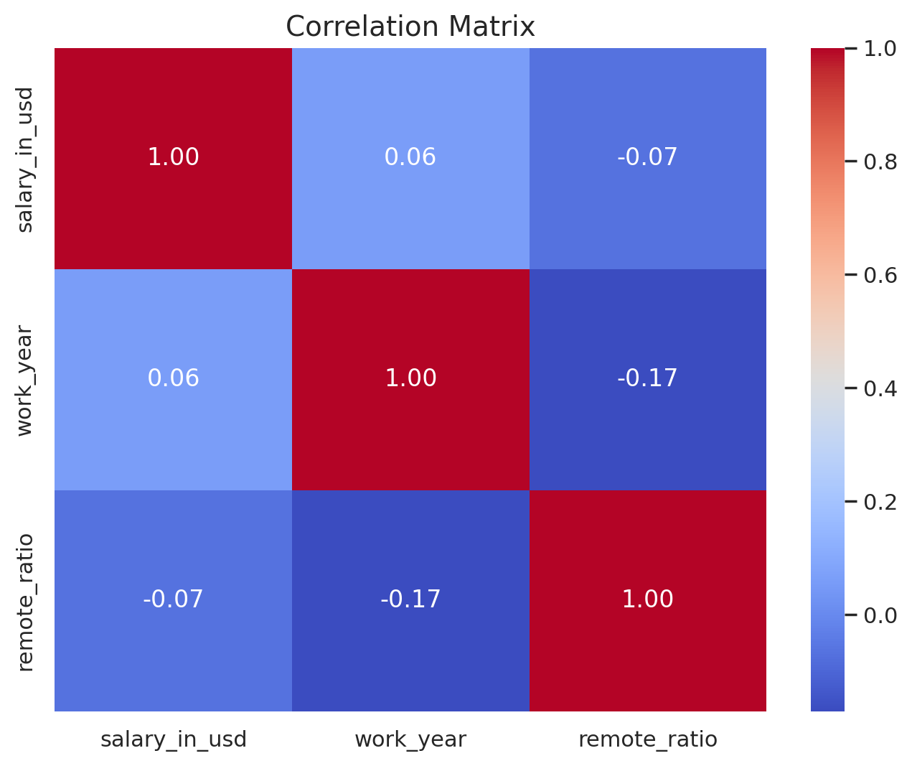
Correlation Analysis:
Correlation Analysis:
Weak correlations observed between salary_in_usd and other numerical variables (work_year, remote_ratio).
Indicates that salary variations are not strongly dependent on these features.

Slide 12
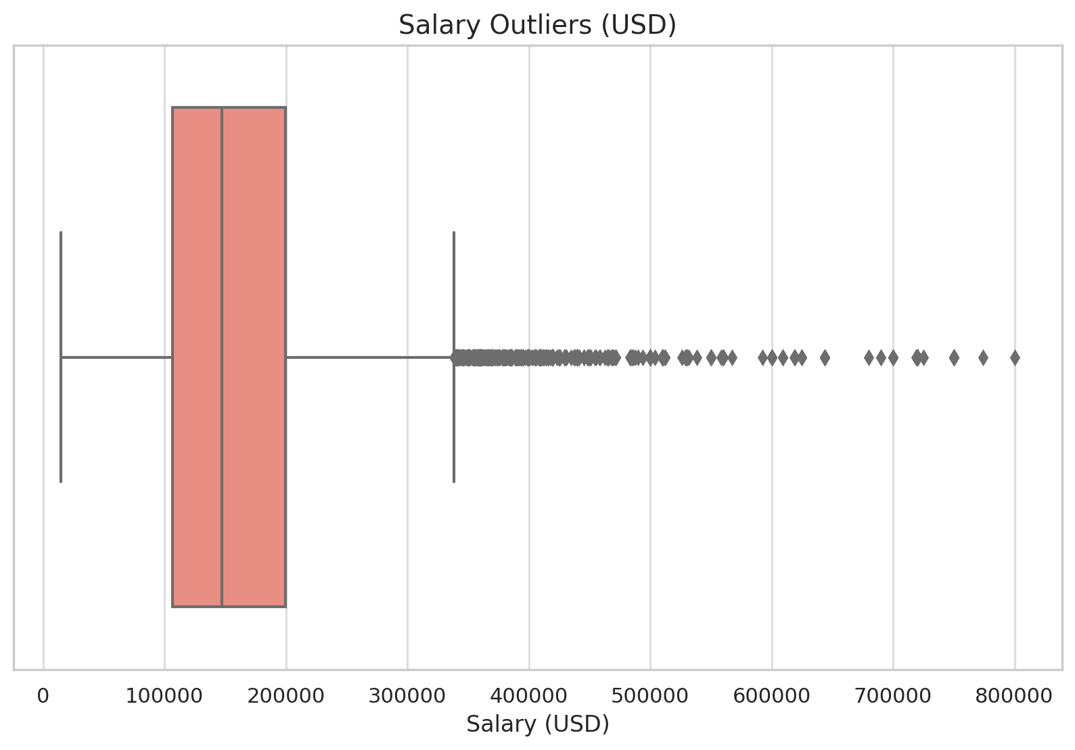
Outlier Detection in Salaries:
The boxplot highlights a significant number of salary outliers above $300,000.
These high salaries may represent niche roles or industries with elevated pay scales.

Slide 13
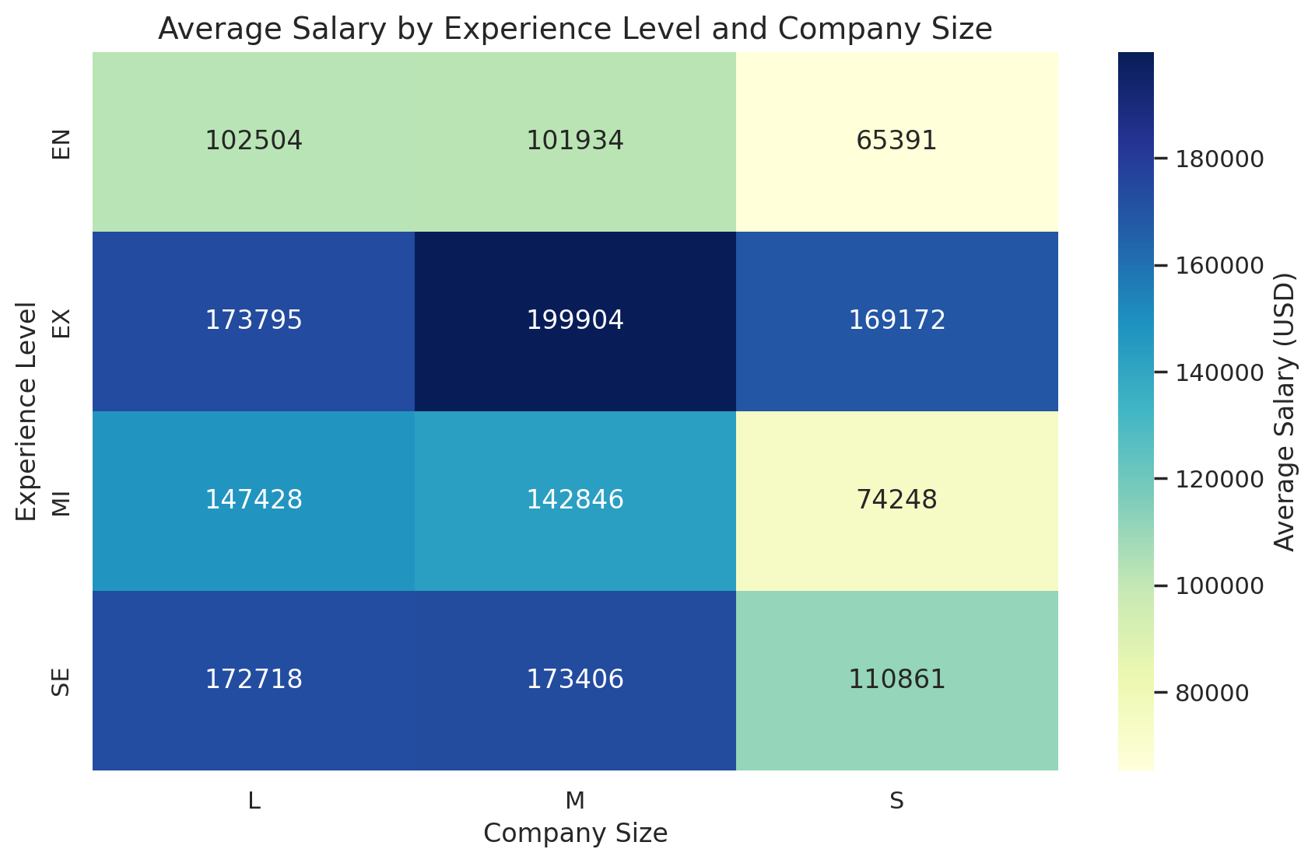
Average Salary by Experience Level and Company Size:
Senior-level roles ("SE") have the highest average salaries across all company sizes.
Large companies ("L") offer the highest salaries for senior roles, while small companies ("S") generally pay less across all experience levels.

Slide 14
Columns Overview:
Numerical Columns:
work_year: Data spans from 2020 to 2025.
salary: Wide range from €14,000 to €11,000,000, indicating potential outliers.
salary_in_usd: Converted salary ranges from $15,129 to $465,972.
remote_ratio: Distribution from 0% to 100%, indicating varying degrees of remote work.
Categorical Columns:
experience_level: 4 unique levels, with "SE" (Senior) being the most common.
employment_type: Predominantly "FT" (Full-Time).
job_title: 126 unique job titles, with "Data Scientist" being the most frequent.
salary_currency: 14 currencies, with EUR (Euro) being the most common.
employee_residence: 48 unique countries, with Germany (DE) being the most common.
company_location: 37 unique countries, with Germany (DE) leading.
company_size: 3 categories (Small, Medium, Large), with Medium (M) being dominant.

Slide 15
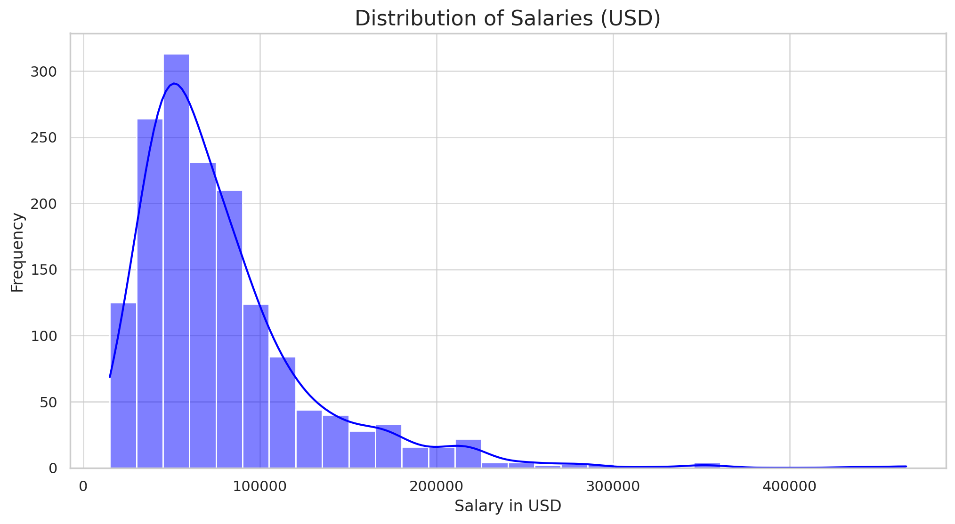
Salary Distribution:
The majority of salaries fall within $40,000 to $100,000 USD.
There are a few significant outliers with exceptionally high salaries, which might require further investigation.

Slide 16
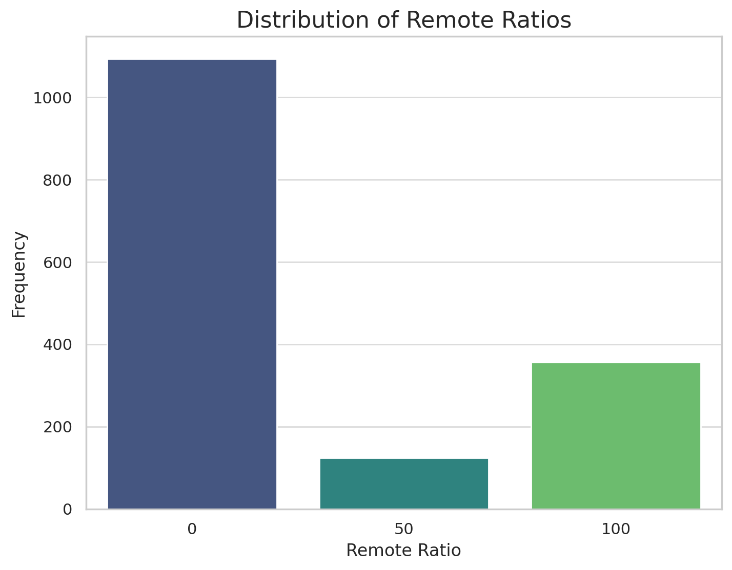
Remote Ratio Distribution:
A large proportion of jobs are fully on-site (0% remote).
There is a notable number of fully remote jobs (100% remote), but hybrid roles (e.g., 50%) are less common.

Slide 17
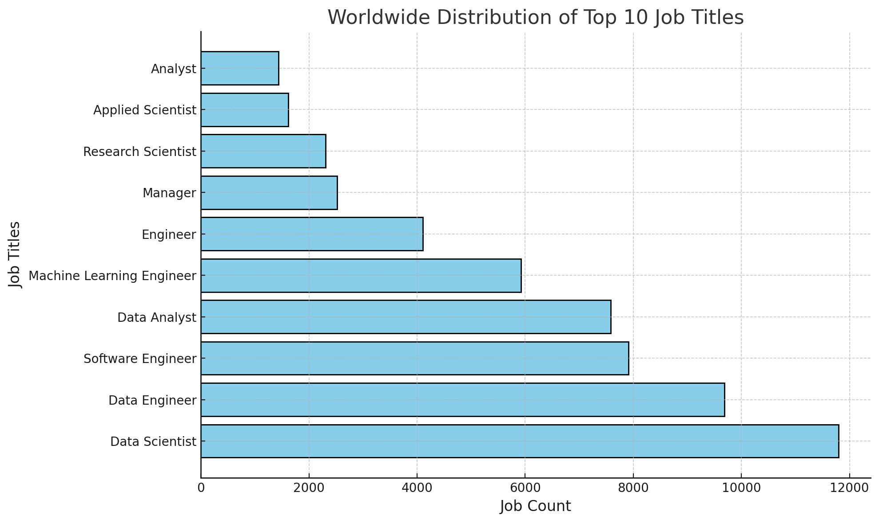
Distribution of top ten Jobs World wide:
Global Trends:
Titles like Data Scientist and Software Engineer often dominate, reflecting their universal demand across industries.
Balanced Representation:
The distribution suggests a widespread need for tech-related roles globally.

Slide 18
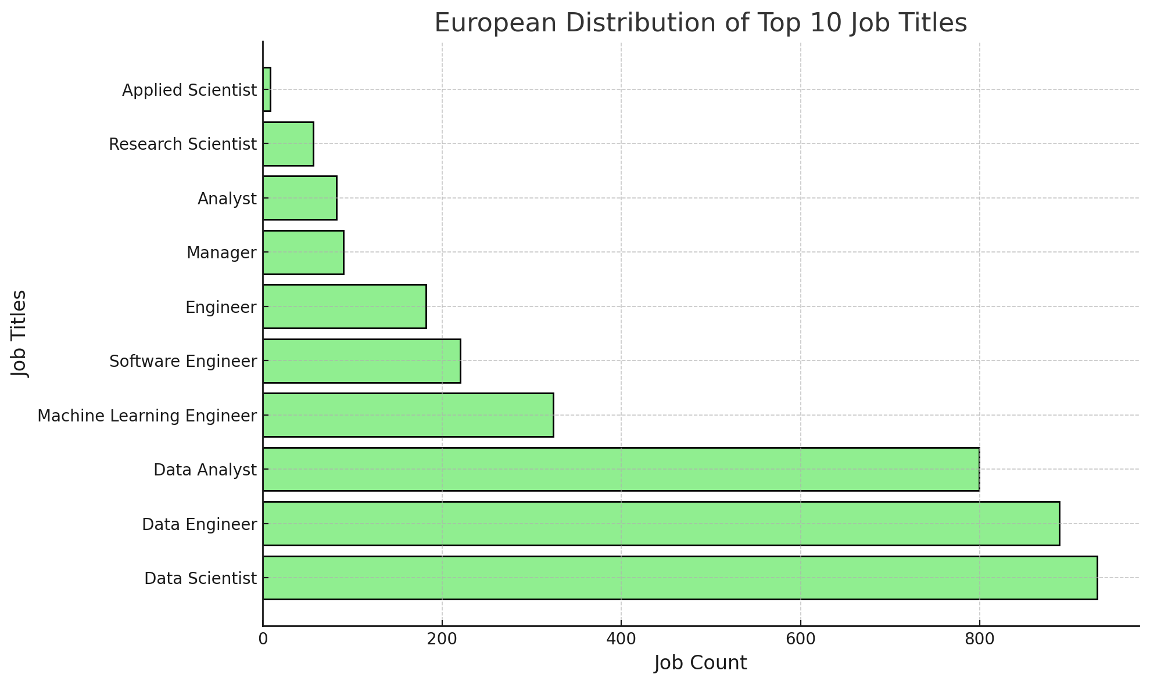
Distribution of top ten Jobs in Europe:
European Focus:
Similar to worldwide trends, roles like Software Engineer and Data Scientist are highly prominent.
Regional Specialization:
Specific roles may show relatively higher counts compared to other regions, indicating regional expertise or demand.

Slide 19
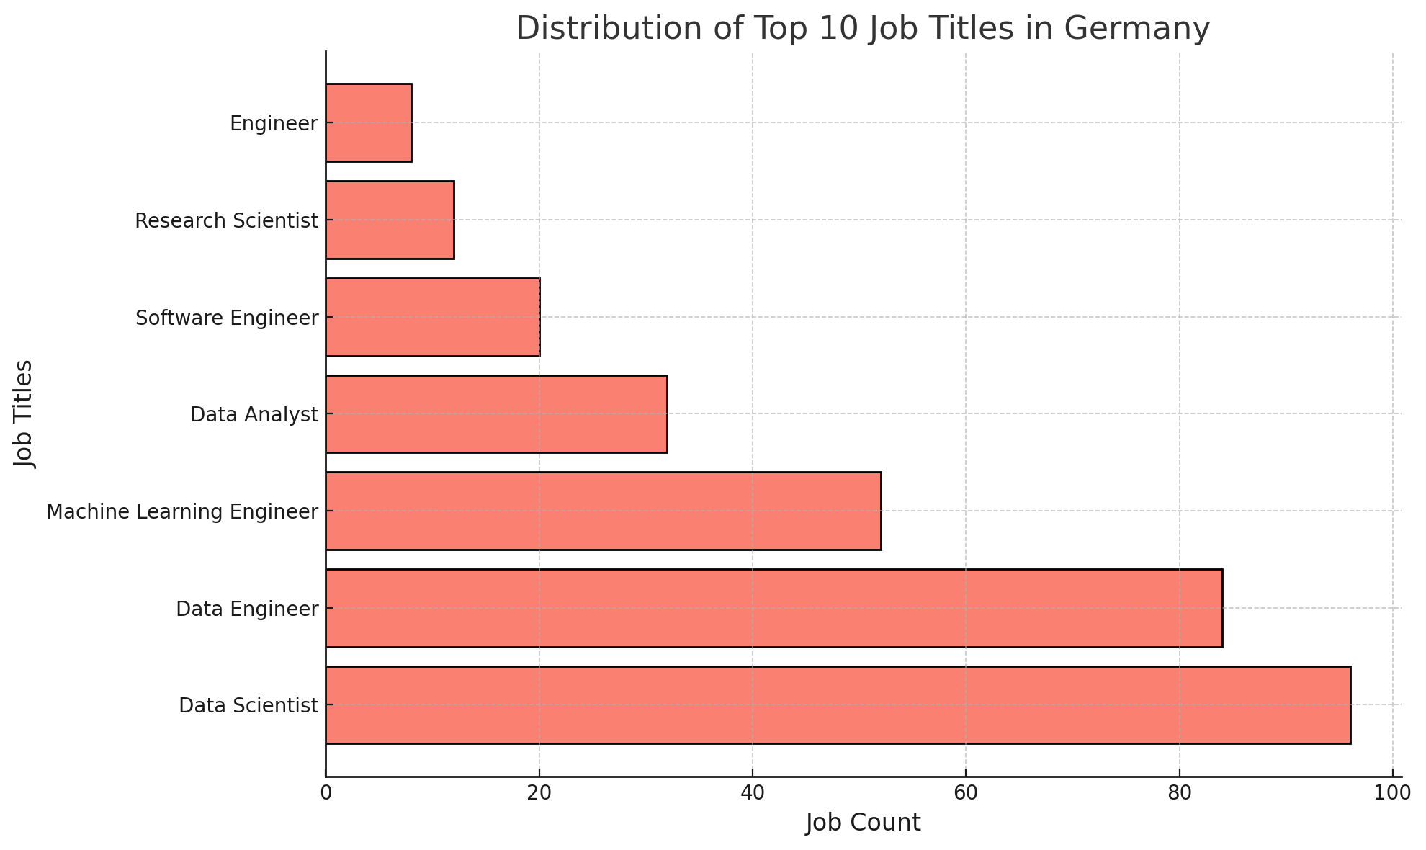
Distribution of top ten Jobs in Germany:
High-Demand Titles: The most common roles reflect Germany's industrial and technological strengths, such as Software Engineer or Data Scientist.Niche Roles: Some job titles may have lower counts, indicating more specialized demand.

Slide 20
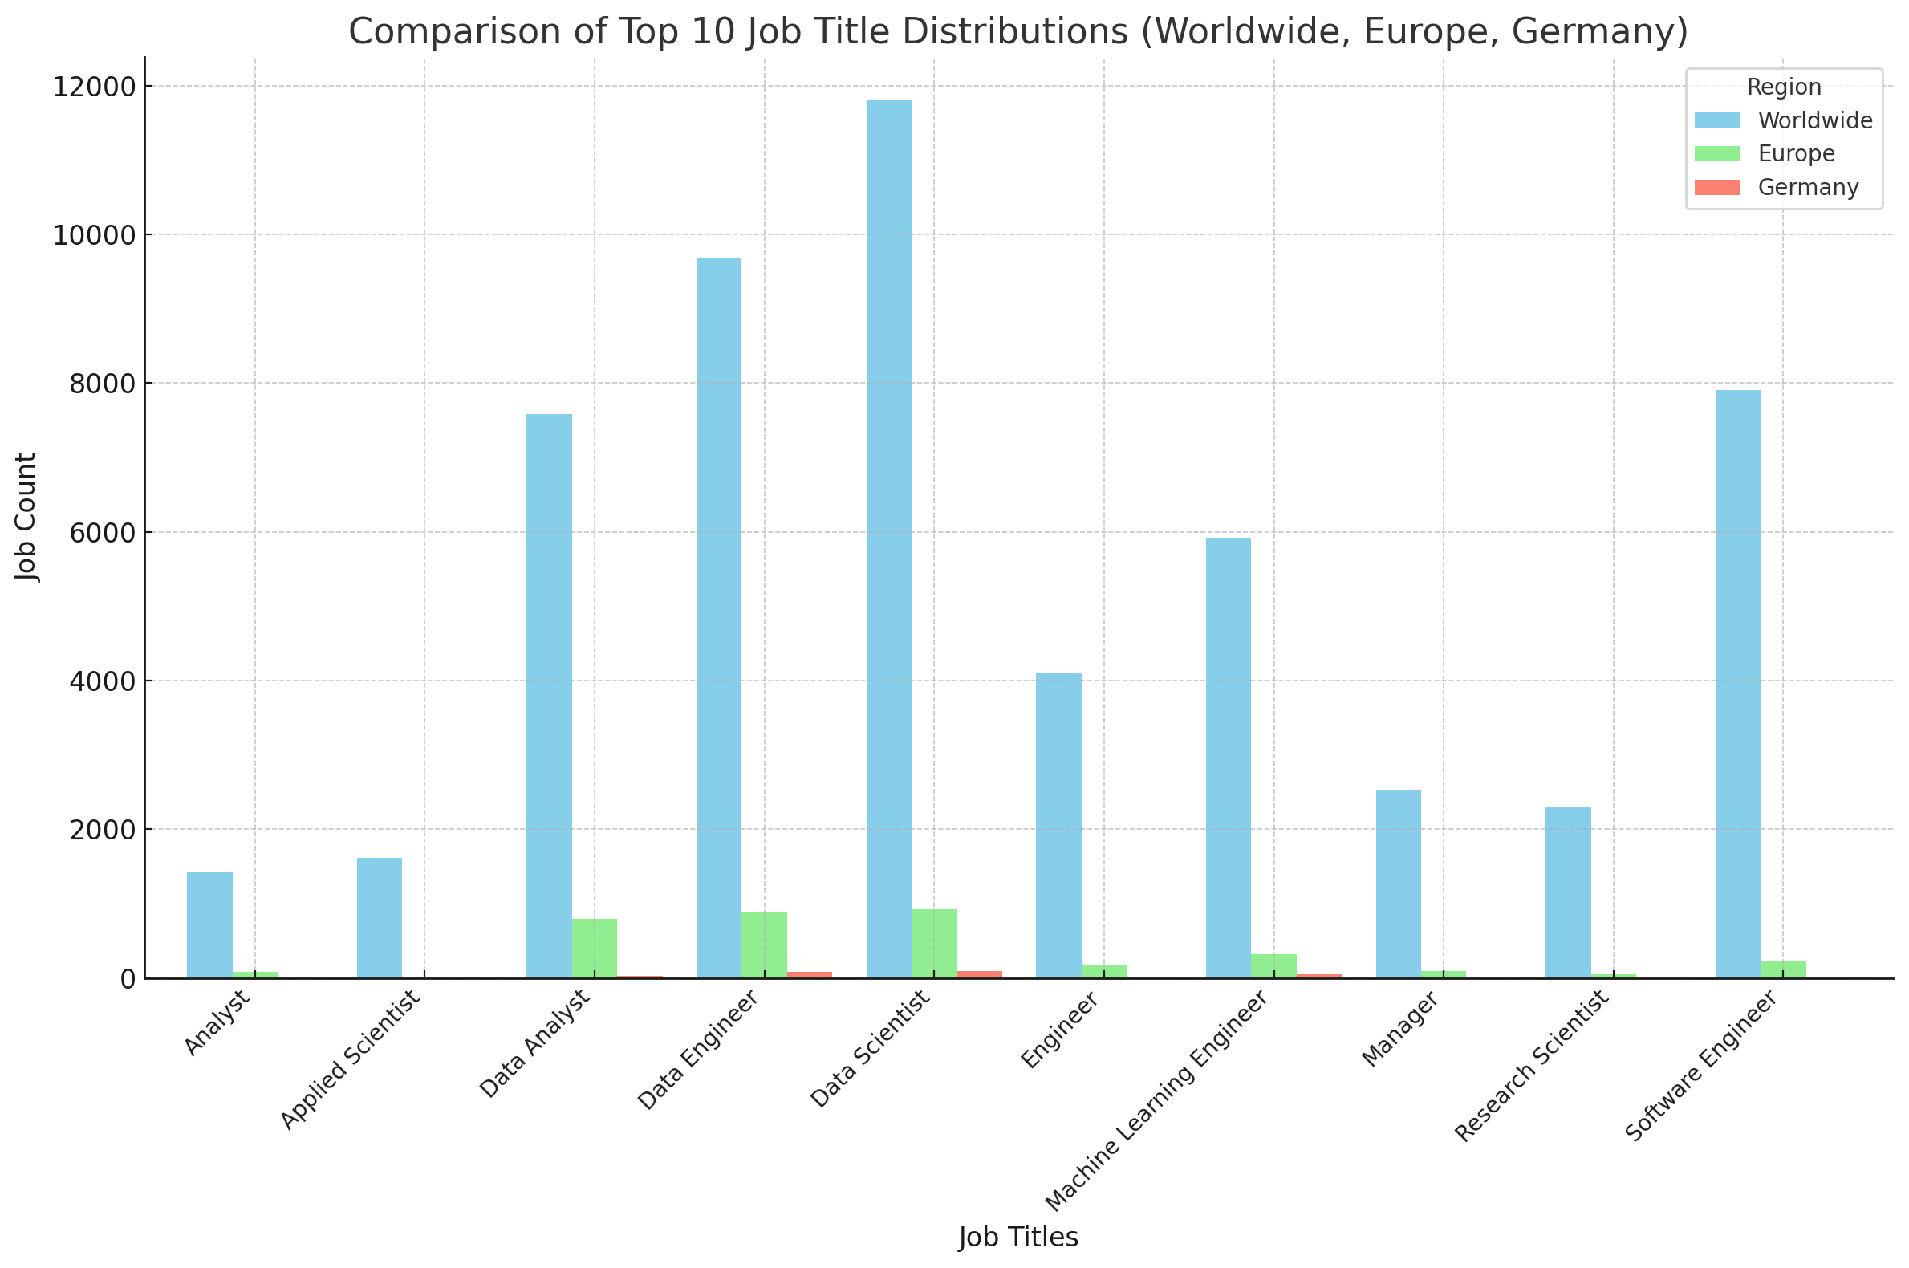
Comparisson Top Ten Titles WW, Europe and Germany
Germany vs. Europe:Some roles may be more prominent in Germany compared to the broader European context, indicating regional demand.
Example: A title like Data Engineer might stand out in Germany due to industrial focus on analytics.
Global Comparisons:Job titles popular globally but underrepresented in Germany may suggest opportunities for growth or skill gaps in the region.
Balanced Trends:Titles with similar counts across all three regions reflect universally high demand.

Slide 21
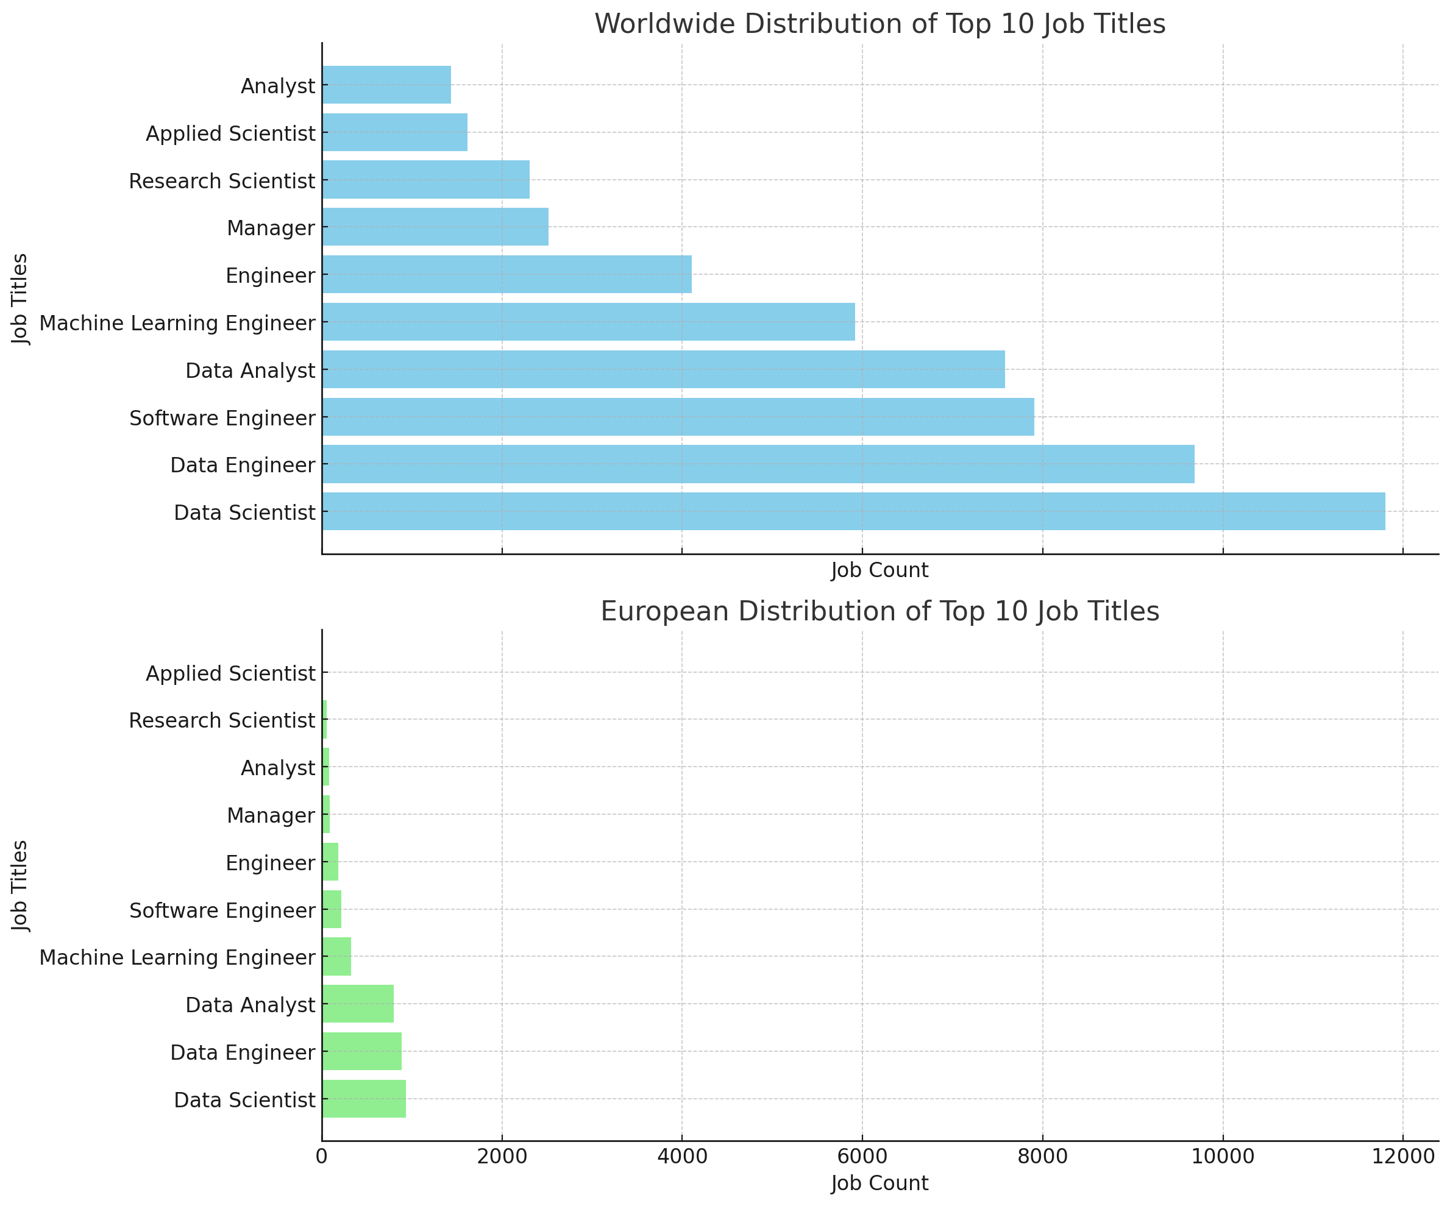
Comparisson Top Ten Titles Europe and Germany
Worldwide Distribution of Top 10 Job Titles: Displays the count of each top job title globally.
European Distribution of Top 10 Job Titles: Shows the count of the same job titles specifically within Europe.

